Slide 1

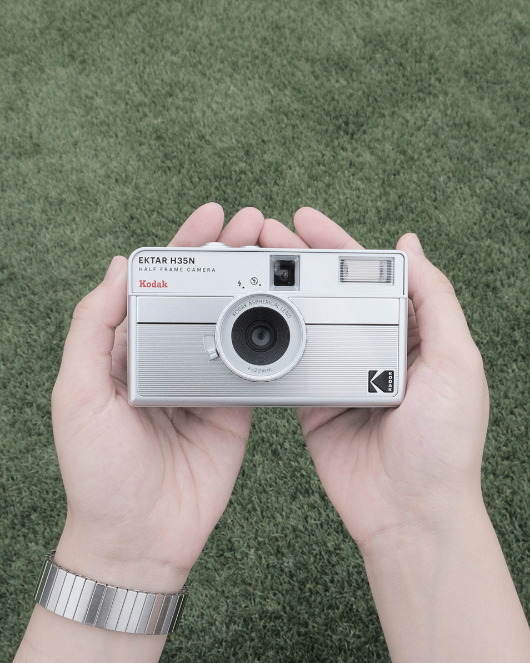
HALF FRAME CAMERA

Slide 2
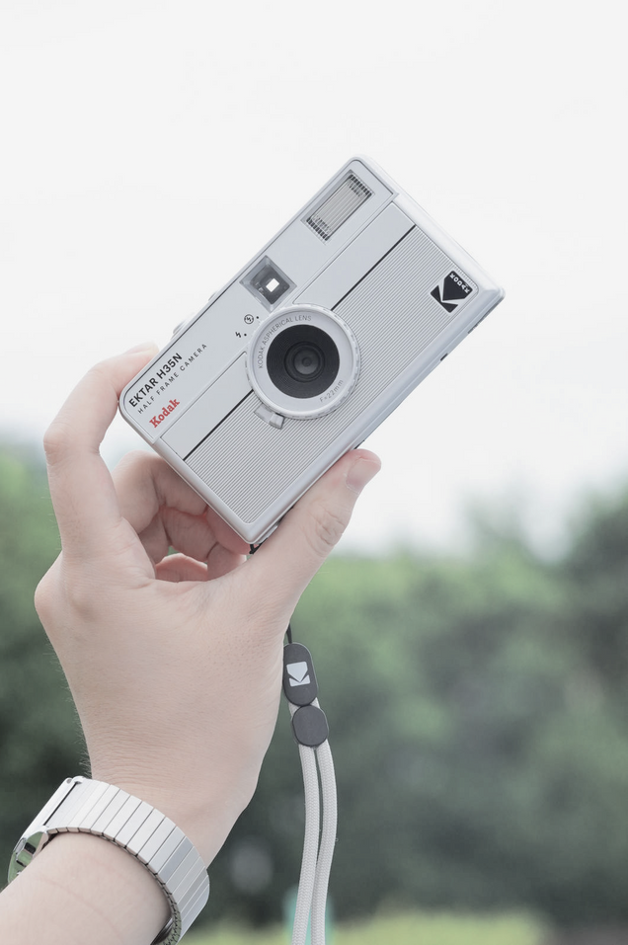
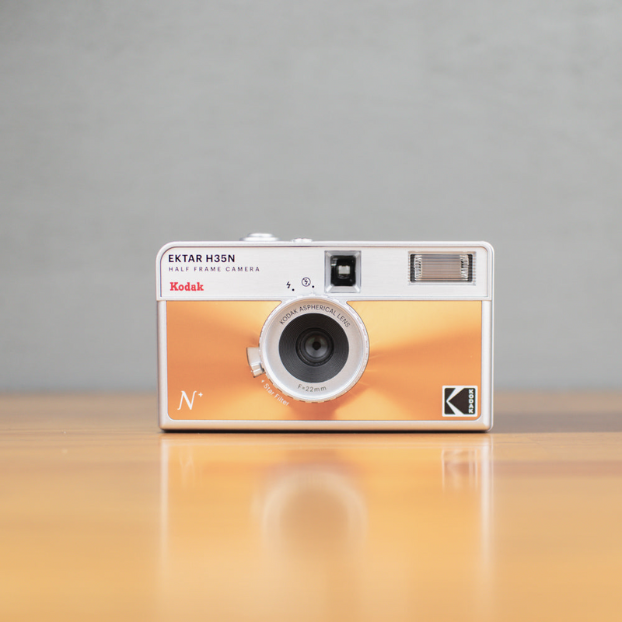
REACH 1000 SALES IN FIRST MONTH
SELL 10,000 BY THE END OF THE QUATER
GAIN 10,000 NEW FOLLOWERS TO OUR ACCOUNT BY THE END OF THE QUATER.
GOAL

Slide 3
THREE INSTAGRAM POSTS PER WEEK
2 TIKTOKS (+REELS) PER WEEK
1 YOUTUBE VIDEO PER WEEK
PLAN

Slide 4
1. Showcase the “Double the Shots” Advantage
Post a short reel/TikTok demonstrating how you get 72 shots on a 36-exposure roll.
Use split-screen editing: one side shows a standard camera burning through shots quickly, the other shows the half-frame lasting longer.
Caption idea: “More memories. Same roll.”
2. Before & After / Creative Pairing Shots
Since half-frame creates two images per frame, show off diptychs (paired photos) that tell a story.
Example: left photo = “before coffee,” right photo = “after coffee.”
Encourage followers to get creative and share their own ideas.
3. Behind-the-Scenes of Film Loading & Shooting
Film a satisfying ASMR-style clip of loading film, winding, and clicking the shutter.
Overlay text like: “Ever shot on half-frame? Twice the fun, half the size.”
Great for reels or YouTube Shorts since it emphasizes the tactile, retro feel.
4. Aesthetic Comparisons (Film vs. Digital)
Post side-by-side shots: one taken with a phone, one with the half-frame camera.
Highlight the film texture, vintage look, and unique character.
Add a caption like: “Can your phone do this?”
5. Community / Challenge Content
Launch a “Half-Frame Challenge” encouraging people to tell a story in two frames.
Share the best user submissions on your account.
Example prompt: “Frame 1: anticipation. Frame 2: the reveal.”
Use the hashtag #halfframechallenge
MARKETING PLANS

Slide 5
DEMOGRAPHICS: AGES 20-40, LOWER-MIDDLE INCOME, NEAR A TOWN OR CITY, ANY EDUCATION LEVEL.
PHYCOGRAPHICS:ARTY, NOSTALGIC, FILM PHOTOGRAPHY BEGINNER, CREATIVE, NON TECHNICAL.
BEHAVOURS: FREQUENT PHOTOTAKER, OUTDOORSY OR SOCIAL, LIKES OLD FILMS OR LIKES THE FEEL OF FILM PHOTOGRAPHY
TARGET AUDIENCE

Slide 6
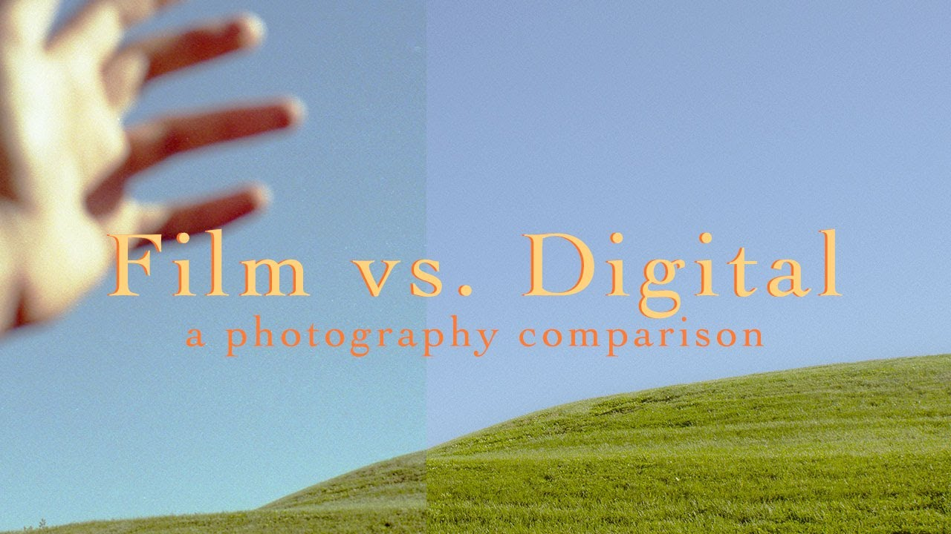
FILM AND DIGITAL COMPARISON POSTS
COMPARE PHOTOS USE A DIGITAL CAMERA AND OUR FILM HALF FRAME TO SEE THE DIFFERENCE IN HOW THEY LOOK.

Slide 7
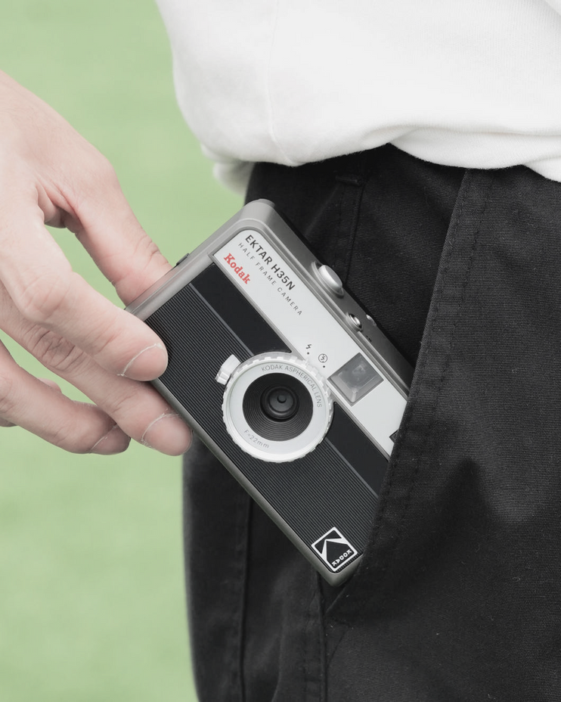
TIKTOK VIDEO IDEA
MAKE A SHORT AND SNAPPY TIKTOK WITH SOMEONE LOADING THE CAMERA BUT ALL THE AUDIO IS ENHANCED FOR THAT ASMR EFFECT. ALSO MAKE IT IN NATURE BECAUSE THAT ALSO SOUNDS NICE.

Slide 8
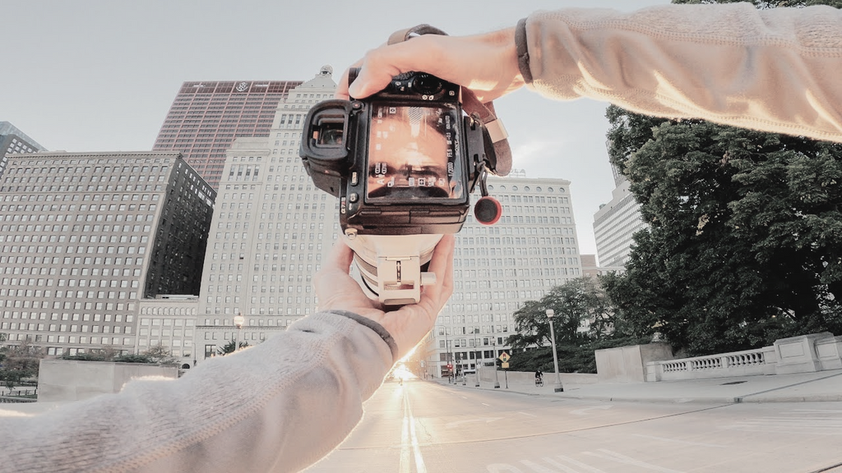
YOUTUBE VIDEO IDEA
MAKE A POV VIDEO USING THE HALF FRAME CAMERA AND TALKING ABOUT THE PROCESS OF TAKING PHOTOS.

Slide 9
INSTAGRAM: THE COMPARISON POSTS WILL BE ENGAGING SO THAT PEOPLE CAN DISCUSS THE DIFRENCES AND THOSE COMMENTS WILL BOOST EXPOSURE. OUR MAIN AUDIENCES IS FIRST TIME FILM PHOTOGRAPHERS AND THEY CAN SEE HOW THE PHOTOS LOOK STRAIGHT OUT OF THE CAMERA WITHOUT DOING ANY EDITING AS YOU WOULD WITH A DIGITAL CAMERA.
TIKTOK: THE TIKTOK IDEA IS GOOD FOR THE GOAL BECAUSE IT’S SHOWING THE TACTIAL NATURE OF FILM CAMEA WHICH ON A PLATFORM LIKE TIKTOK WHERE EVERYTHING IS FAST AND CONVENET, THE JUXTOPOSITION OF SOMETHING SLOW AND PHYSICAL WOULD BE GOOD TO SHOWCASE.
YOUTUBE: THE YOUTUBE VIDEO WILL HELP THE GOAL AS IT SHOWS THE FEATURES OF THE CAMERA IN REAL TIME WHICH WILL SHOW HOW EASY IT IS TO USE THUS REDUCING THE BARRIOR OF ENTRY. OUR AUDIENCE WILL LIKE IT BECASE IT SHOWS THAT ANYONE CAN USE IT AND BE CREATIVE.
EXPLANATION

Slide 10
REACH: INCREASE REACH OF HOW MANY PEOPLE, SEE THE CONTENT, GOAL IS 10,000 FOLLOWERS.
ENGAGEMENT: MORE PEOPLE LIKING, COMMENTING AND SHARING THE POSTS AND INTERACTING WITH THE PRODUCT WITH THE HASHTAG.
CONVERSION: CONVERTING ENGAGEMENT TO SALES VIA THE WEBSITE OR ANY ONLINE/IN PERSON SELLER. AIM IS 1000 IN THE FIRST MONTH
BRAND AWARENESS: MORE PEOPLE ARE AWARE OF THE BRAND AND HOW THEY’VE DIVERSIFIED.
RESULTS

Slide 11
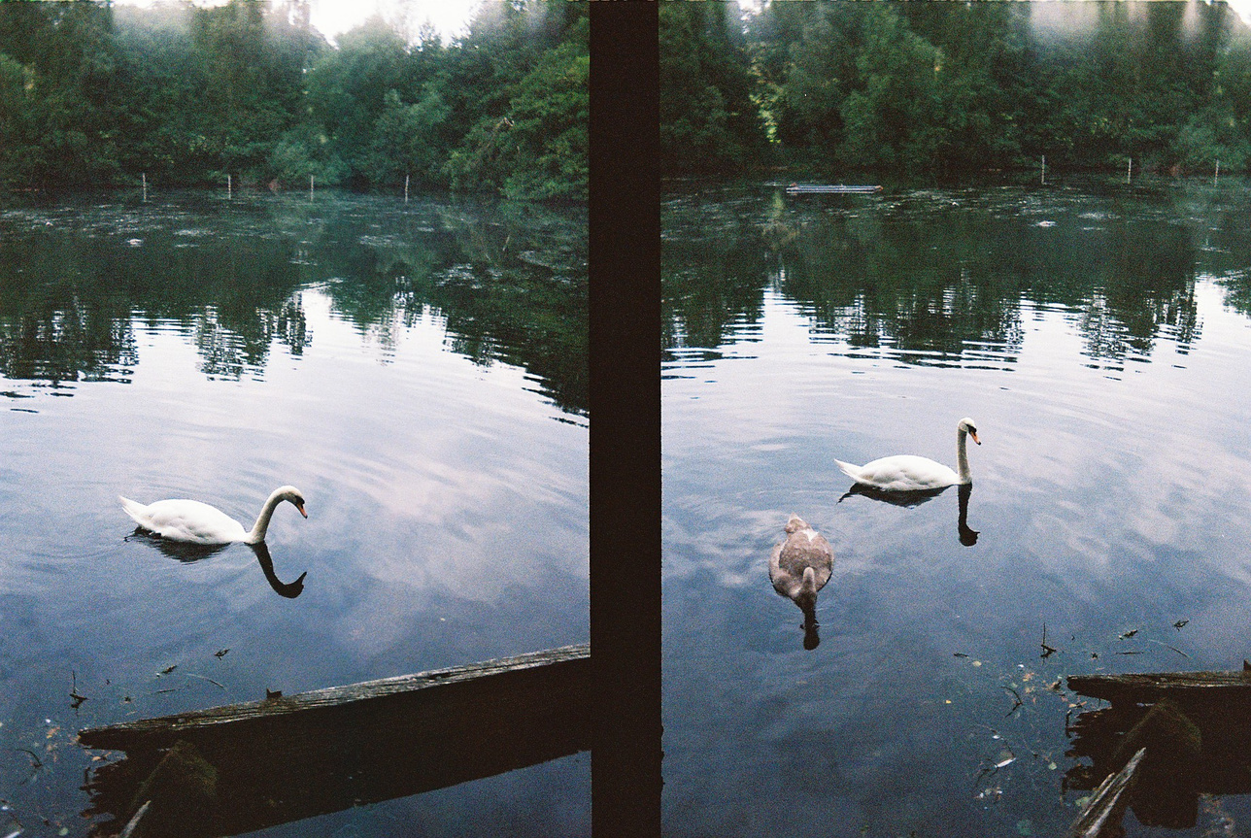
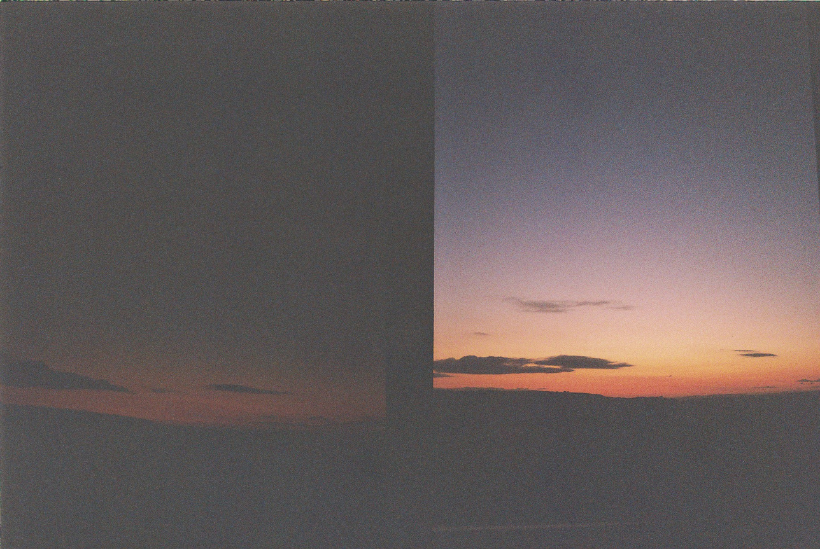
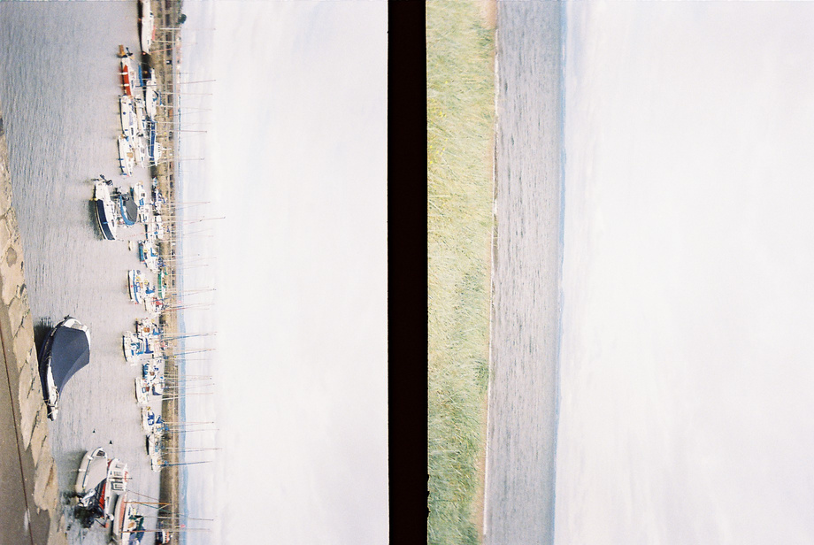
THANK YOU

